Slide 1

GUIDELINES FOR SHEET METAL BOM CONVERSION TOOL
Document:
Rev: 0
Date: 28-JUN-2020
Type: Training Material
Confidential & Proprietary

Slide 2

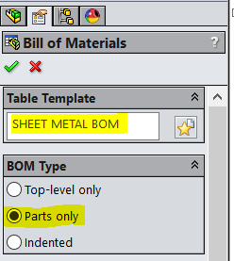
INPUT PREPARATION:
Open any Sheet Metal Assembly and go to “Insert>Tables>Bill of Materials”.
Select “Sheet Metal BOM” as Table Template and BOM Type should be in “Parts only”. Then press Enter.
Confidential & Proprietary

Slide 3
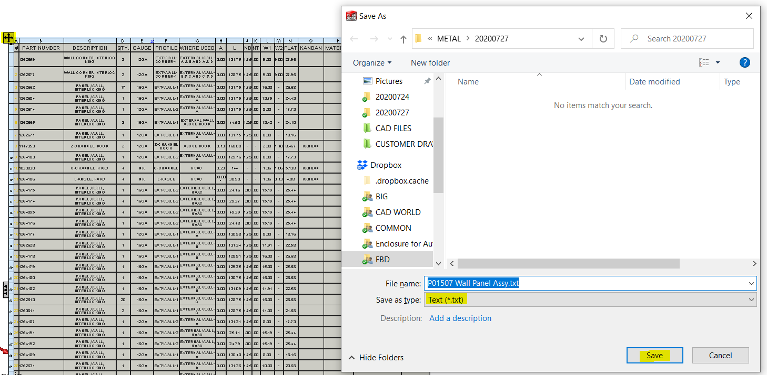
INPUT PREPARATION:
Right Click on the Corner of the table and and save the BOM as .txt file.
Confidential & Proprietary

Slide 4
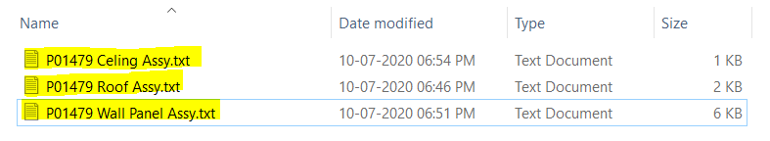
INPUT PREPARATION:
Based on your preference you can do the following:
Save Sub-Assemblies of Sheet Metal Assembly (Wall Panel Assembly, Ceiling Assembly & Roof Assembly) in separate .txt files.
Or you can extract single .txt file from the Sheet Metal Assembly directly.
Both approach will work with this tool.
Approach 1:
Approach 2:
Confidential & Proprietary

Slide 5
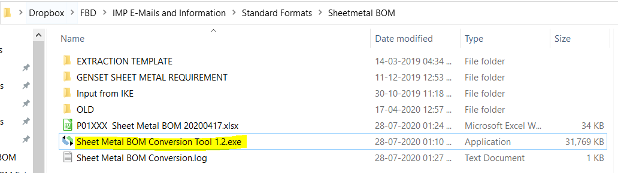
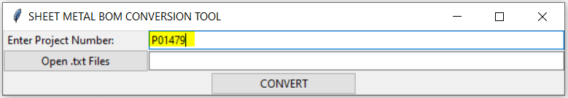
WORKING WITH THE TOOL:
Double Click on the “Sheet Metal BOM Conversion Tool 1.2.exe” file to open the tool.
Enter Project Number in the first field.
Make sure you are adding alphanumeric characters only in Project Number Field, otherwise it will raise an error.
Confidential & Proprietary

Slide 6
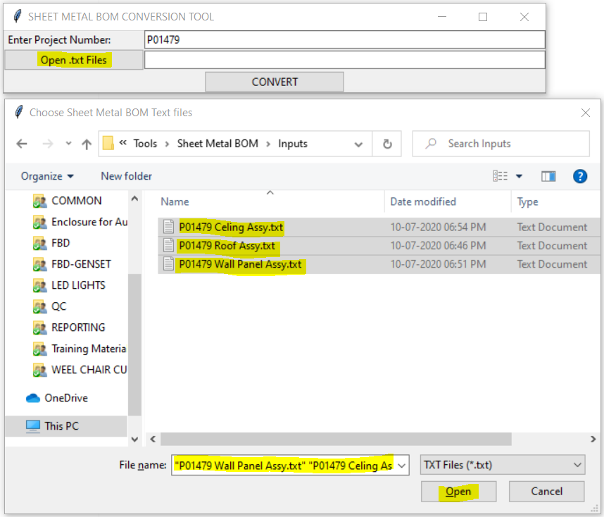
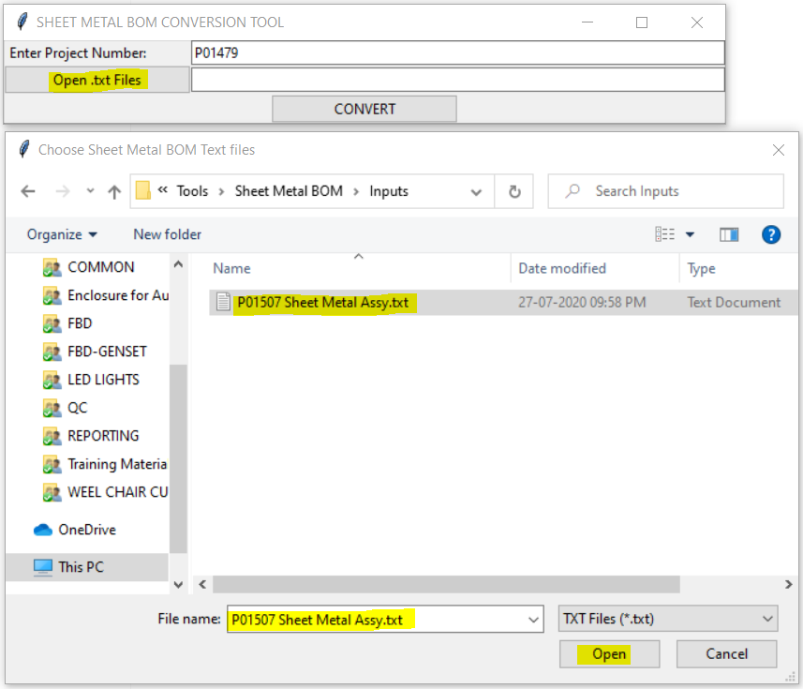
WORKING WITH THE TOOL:
3. Track and open the Text Files using “Open .txt Files” Button.
You can select multiple files or a single file based on your approach.
Approach 1
Approach 2
Confidential & Proprietary

Slide 7
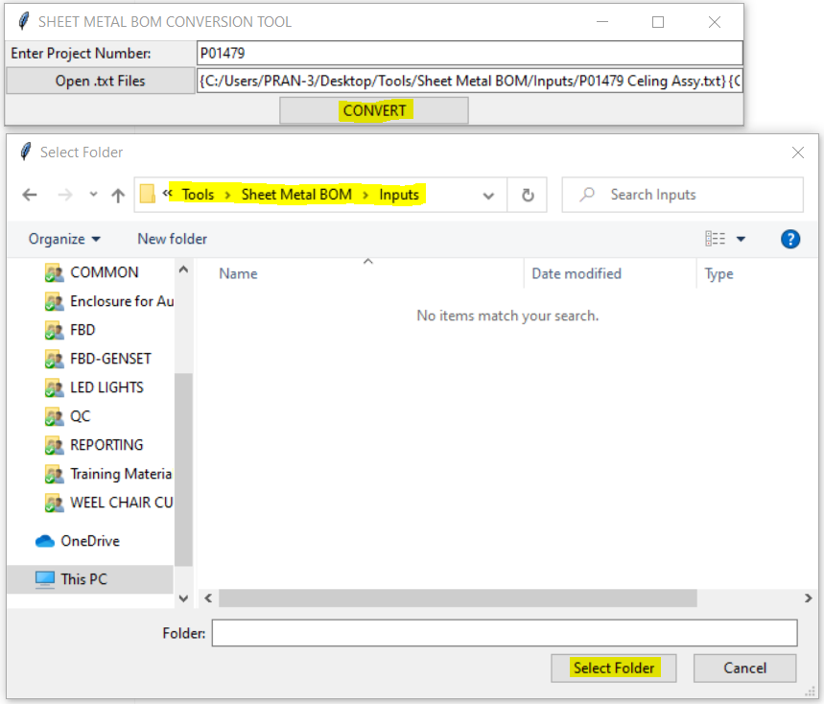
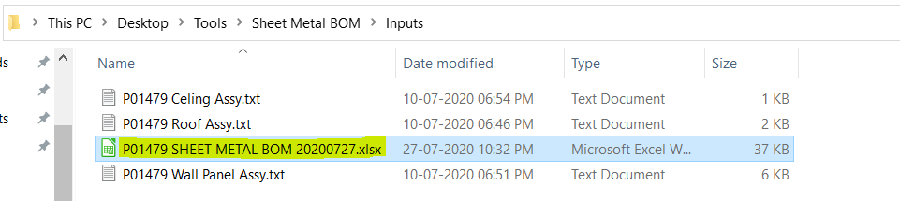
WORKING WITH THE TOOL:
4. Press the “Convert” Button. Track and select the folder location in which you want the file to be saved.
Once the process completed, the tool will close automatically and you can see the output file in the given location.
Confidential & Proprietary

Slide 8
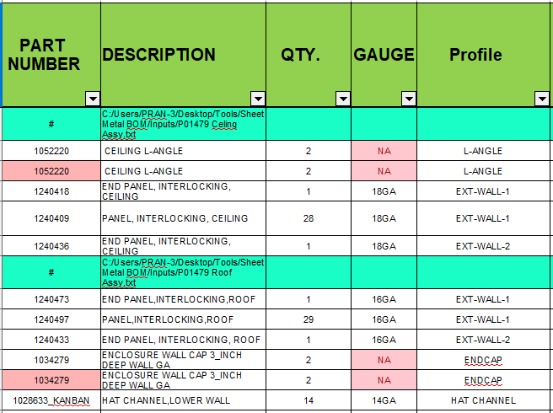
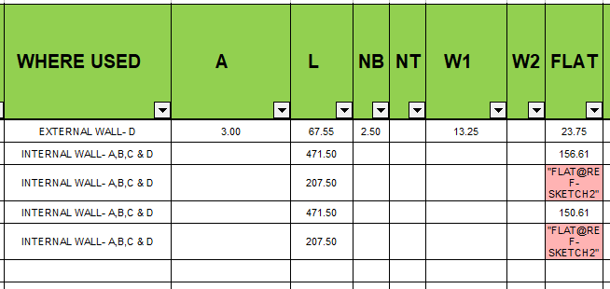
COLOUR CODING OF OUTPUT FILE:
1. Rows with highlights in Light Green Colour means the the contents of a file you selected starts from that row.
2. Cells in column “PART NUMBER” may highlight in Red Colour if the part number is repeated (Note: First Entry will not get highlighted). Please update Qty. and Length manually as required.
3. Cells in column “GAUGE” is having a conditional formatting to detect “NA” or Blank Cells.
4. Cells in columns “A”, “L”, “NB”, “NT”, “W1”, “W2” & “FLAT” may highlight in Red Colour if the value is not numerical in nature.
Confidential & Proprietary

Slide 9
POST-PROCESSING THE DOCUMENT:
The data on the Output file should not be used directly for submission.
Clean-up work should be done (i.e, removing unwanted parts, correcting quantities, etc.)
Please report if you see any errors in the tool so that we can rectify it.
Confidential & Proprietary

Slide 10
Thank You !
Give us an Opportunity !!
“ You pick the right people and give them the opportunity to spread their wings and put compensation as a carrier behind it you almost don't have to manage them.”
- Jack Welch; CEO General Electric Company
Confidential & Proprietary

